Slide 1

CSE 515A
Software Engineering for Data Scientists
Visualization in Python
David Beck^{1,2}, Joseph Hellerstein^{1,3}, Jake VanderPlas^{1,4}
Jay Garlapatti³
¹eScience Institute
²Chemical Engineering
³Computer Science Engineering
⁴Astronomy
University of Washington
April 11, 2017

Slide 2
Agenda
Why visualize data?
Elements of visualization design
Python packages for visualization
In-class exercise
Beck, Hellerstein & VanderPlas, 2016

Slide 3
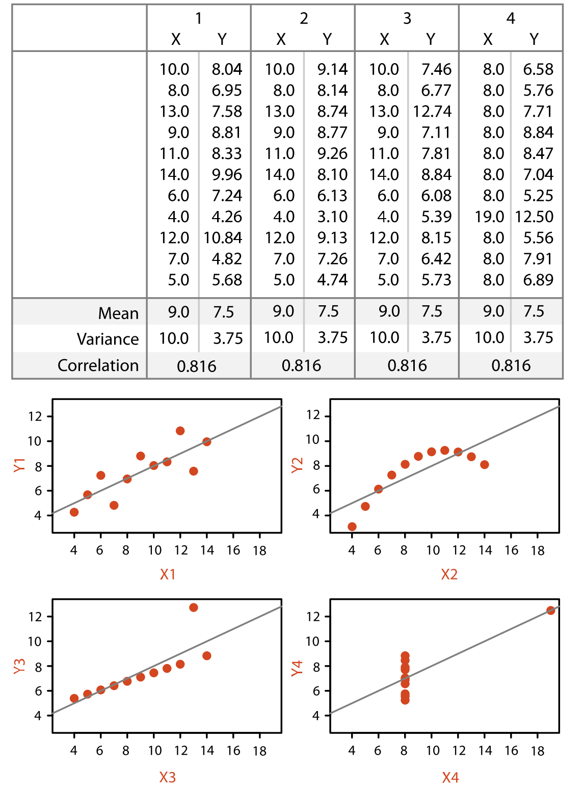
How do these data differ?
Beck, Hellerstein & VanderPlas, 2016

Slide 4
Why Visualize?
Discovery
Inference
Communication
Beck, Hellerstein & VanderPlas, 2016

Slide 5
Terminology in Visualization Design
Representation
  Environment for visualization (e.g., 2d, 3d, sound)
Idiom
  Constructs used (e.g., bar plot, area plot)
Task
  What the user is trying to do (e.g., compare, predict, find relationships)
Design
  How the idiom and representation are used to perform the task
Beck, Hellerstein & VanderPlas, 2016

Slide 6
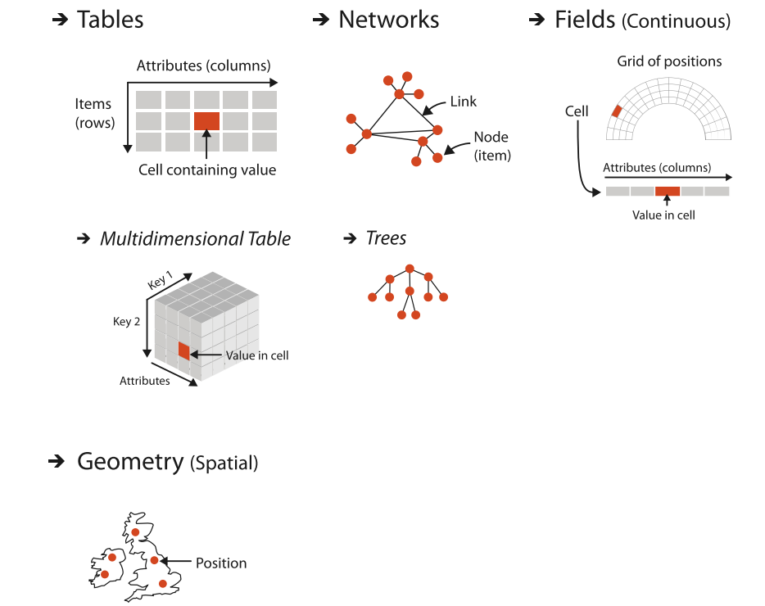
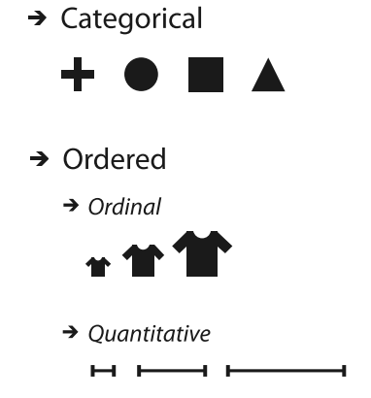
Data Characteristics & Visualization Design
Relationships Between Data Items
Data Values
Beck, Hellerstein & VanderPlas, 2016
Notes:
Looking for characteristics that easily map into a visual representation

Slide 7
Python Visualization Packages
matplotlib – MATLAB plotting in python
pandas – Visualization of pandas objects
seaborn – Statistical visualizations
bokeh – Interactive visualization using the browser
HoloViews – Simplified visualization of engineering/scientific data
VisPy – fast, scalable, simple interactive scientific visualization
Altair – declarative statistical visualization
Beck, Hellerstein & VanderPlas, 2016

